Slide 1
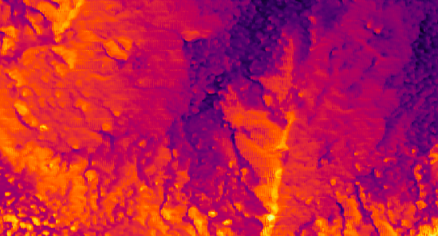
The Microclima Cinematic Universe
13th November 2024

Slide 2
MicroClima
The original model. You can either load your own DEM or choose a location and have a DEM imported online from MapZen.
You can run for any time period and the output will give you a raster map with microclimate variables at the height from surface you have selected.
SLOW but you can get a lot of good data out of it!
https://github.com/ilyamaclean/microclima

Slide 3
MicroPoint
This is similar to microclima but allows you to run microclimate models for discrete points, and therefore runs a lot more efficiently.
You can easily get microclimate time series data from this package.
FAST but more suited to discrete coordinates
https://github.com/ilyamaclean/micropoint

Slide 4
MicroClimF
This is similar to microclima (i.e. you can model spatial climate 'grids' but it specialises in below-canopy and below-ground.)
It also allows you to customise more based on canopy characteristics / leaf foliage density / vegetation height etc.
Faster than microclima, slower than micropoint
https://github.com/ilyamaclean/microclimf

Slide 5
How does it work?
Near-Surface Temperature Estimation - Accounts for the dif between ground-level and reference air temperature using radiation flux and heat transfer.
Radiation Balance – fits around topography and vegetation cover to estimate net radiation.
Wind Speed – Uses imported terrain and veg data to adjust wind speed at different heights.
Mesoclimate – factors in elevation and coastal proximity
Maclean, I. M., Mosedale, J. R., & Bennie, J. J. (2019). Microclima: An r package for modelling meso‐and microclimate. Methods in Ecology and Evolution, 10(2), 280-290.

Slide 6
Where does the data come from?
DEMS – either from your own that you import, or from MapZen online
Leaf Area Index - from NDVI BlueSky, and canopy height from gridded LiDAR data
Climate variables – from NCEP and NOAA

Slide 7
Code
Upload raster file. Because I’m looking at only a small part of the map I cropped my raster to lie only within the bounds of the sampling points.

Slide 8
Code
Feed the model your cropped raster file, and state the resolution at which you want to run (3m here), then choose a date (or range of dates if you want to produce multiple maps), select habitat type.
L = leaf area index
X = leaf geometry index
Hgt = define surface temp to predict (10cm off ground here)
Plot progress = shows progress of data being loaded in and some fun spare maps. Something fun to watch as you wait for it to run. Main source of entertainment for me in August.

Slide 9
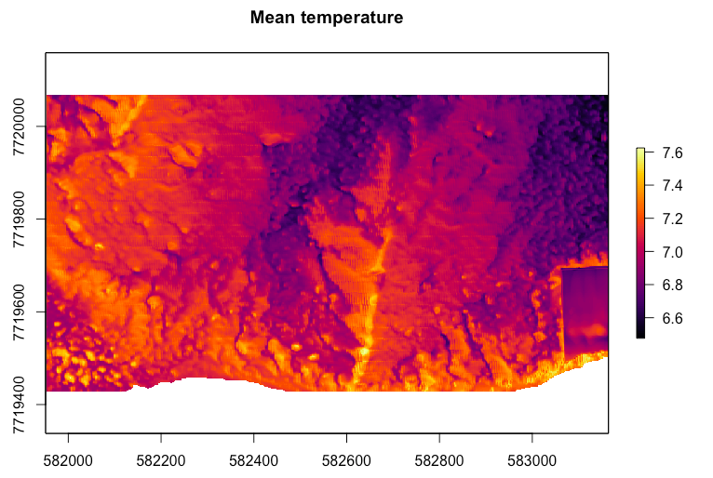
Output

Slide 10
Use cases
Ground-truthing
Site selection
Estimation where you can’t deploy loggers
Gap-filling
You can also manually edit the base code to import historic / paleoclim data

Slide 11
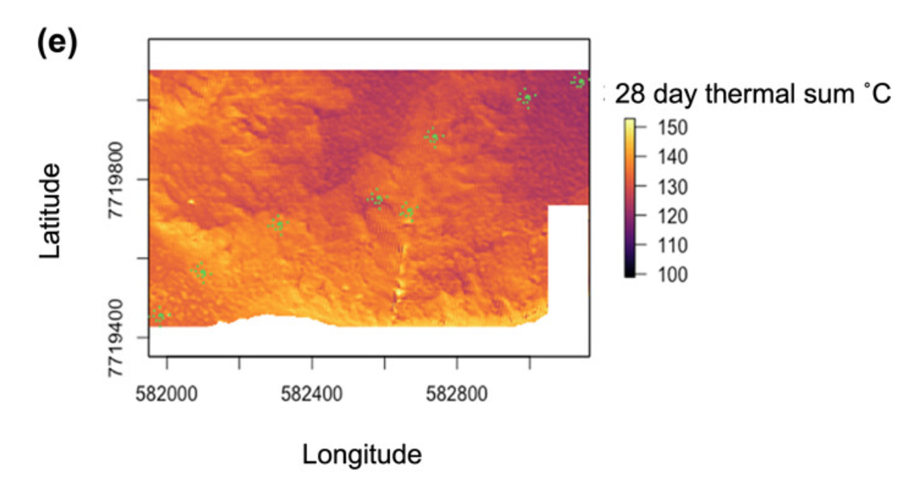
Can stack rasters to create thermal sums

Slide 12
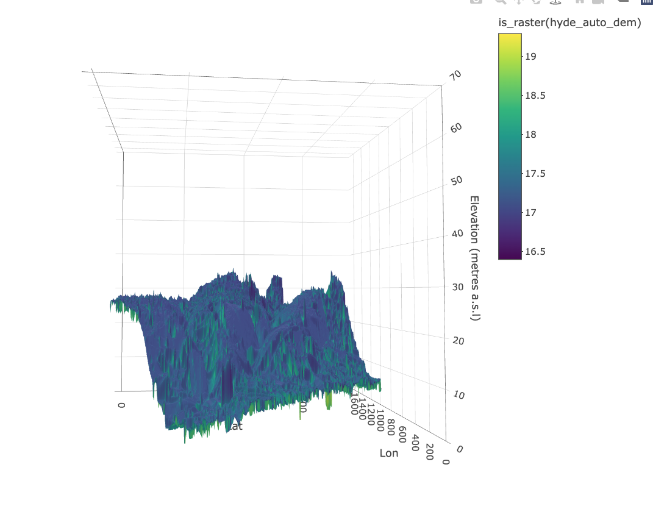

Slide 13
https://github.com/BioDivHealth/microclima_tutorial
Make sure you have the latest version of R
Known issues: high deprecation risk and low repo maintenance

